Slide 1
CO226 DATABASE PROJECT

Slide 2
Problems
At Highway Toll booths:
Ticketing is done manually
No license/eco test or insurance validation
Long queues

Slide 3
Real Time Vehicle Identification
Solution
Using Image Processing

Slide 4
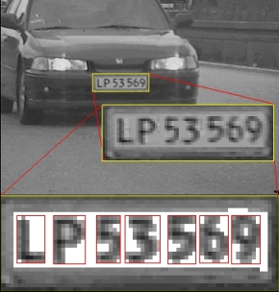
Solution
At the highway entrance, Registration number of vehicles can be detected using camera images
No human interaction
No vehicle queue

Slide 5



Solution
Each identified vehicle is searched in the existing database which has all the details about a particular vehicle
Observing previous records, License/ Insurance validity or Eco test information can be obtained.

Slide 6
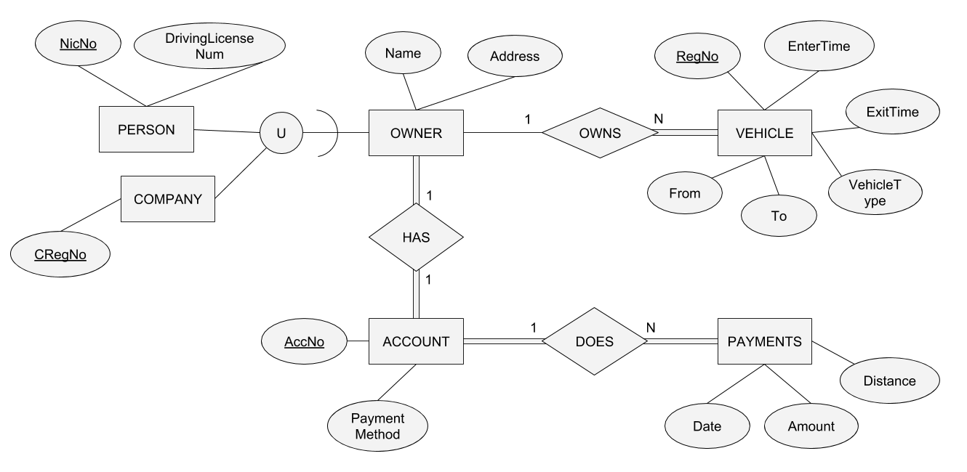
EER Diagram

Slide 7
Benefits
No long queues
Saves time
Easy payment
No illegal vehicles
High speed checking

Slide 8

Other Implementations
Road surveying
Traffic control
Car-park ticketing
Company vehicle records
Prediction of accidents

Slide 9
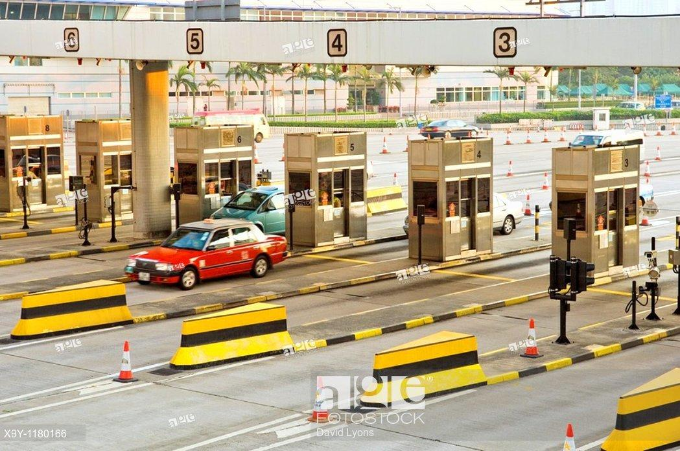
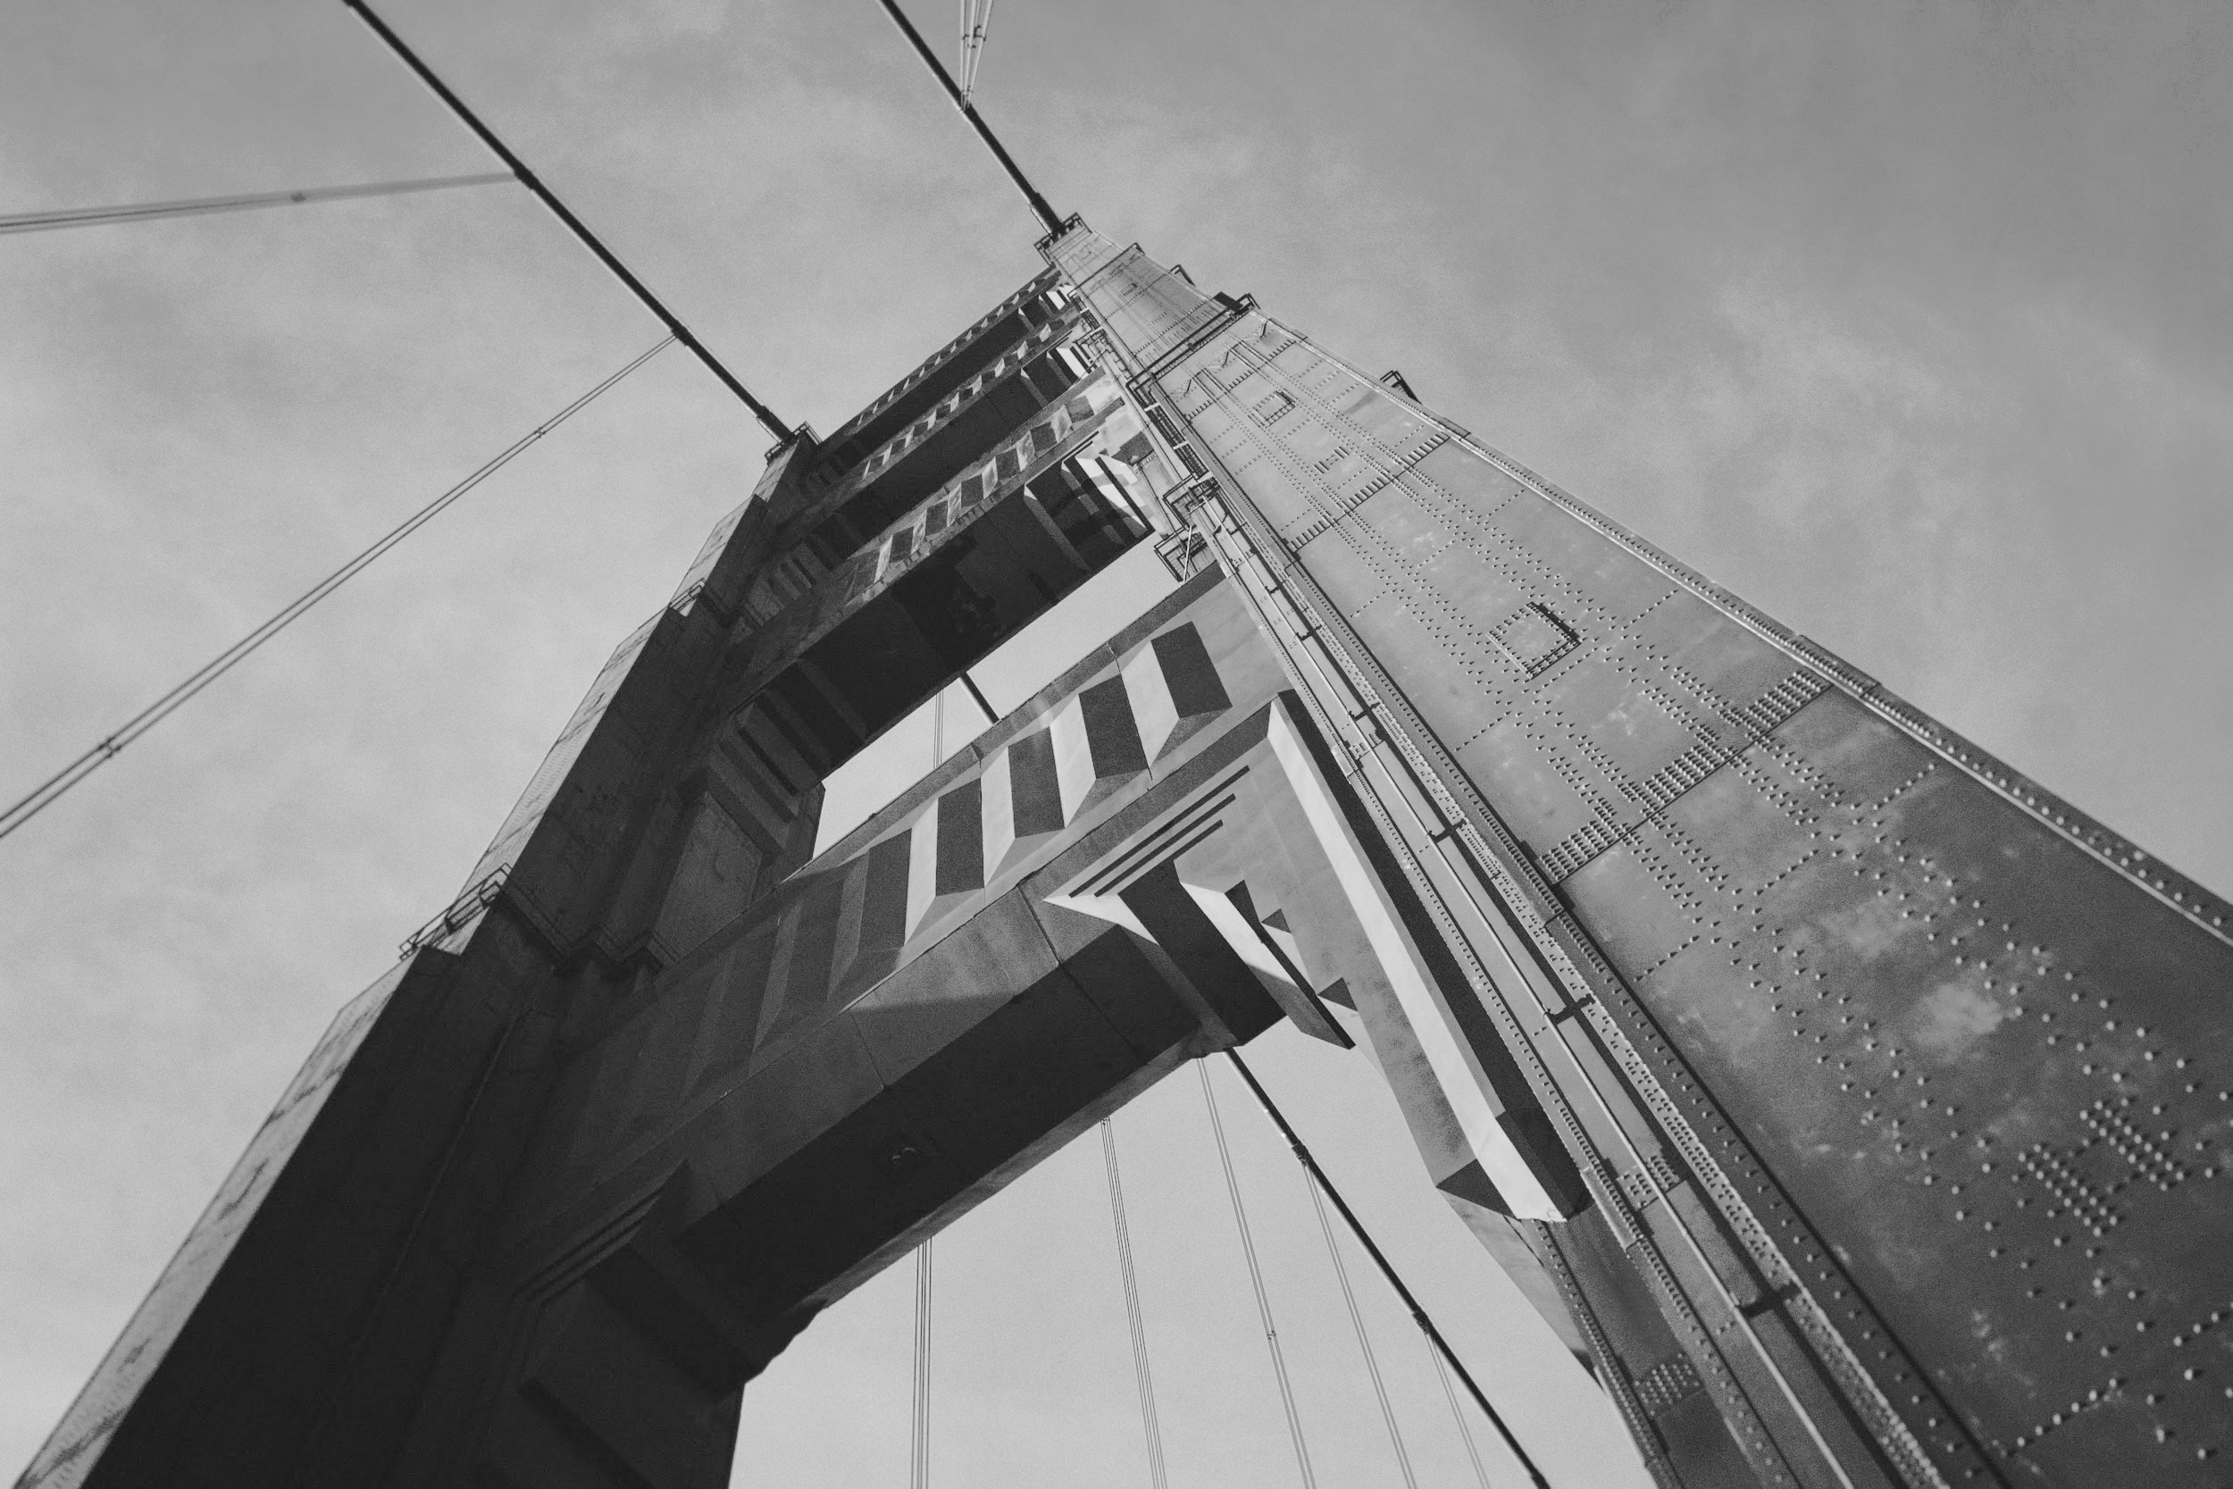
Thanks!
Group members
E15/092 Ekanayake I.U.
E15/173 Karunarathna S.D.D.D.
E15/280 Premathilaka M.P.U.
E15/316 Samarasinghe U.G.S.B.
E15/350 Tennakoon M.P.B.

